Slide 1
Module 5: Cloud Billing and Support Services
© 2018, Amazon Web Services, Inc. or its Affiliates. All rights reserved.
Notes:
Welcome to Module 5 – Cloud Billing and Support Services.

Slide 2
What’s In This Module
Part 1: Introduction to AWS Organizations
Part 2: AWS Cost Explorer
Part 3: Overview of AWS Technical Support Plans and Costs
Notes:
The billing and support services module was designed to provide an overview of AWS billing and support services. We will review AWS Organizations, which is how you manage multiple AWS accounts and consolidated billing. We will also look at look at some tools that enable you to view and estimate costs.
Finally, we will close with a look at how to find AWS white papers and documentation on all AWS services, features, and resources.

Slide 3
Module Overview
Review and understand AWS Organizations, billing, and technical support options to enable you to:
Understand how set up an organizational structure that simplifies billing and account visibility to review cost data.
Identify alternative Support options and features.
Notes:
How you are charged for using AWS can be very complicated. To help, AWS provides a billing tool to help users understand how much they are spending in AWS.
Technical support of any solution is critical. In this module you will gain the insight needed to select the support solution that best meets your needs and budget.

Slide 4
Part 1: AWS Organizations
Notes:
Introducing Part 1: AWS Organizations. In this part, we’ll look at AWS Organizations and consolidated billing, along with its features and benefits.

Slide 5

Introduction to AWS Organizations
AWS Organizations
Notes:
AWS Organizations is an account management service that enables you to consolidate multiple AWS accounts into an organization that you create and centrally manage. AWS Organizations include consolidated billing and account management capabilities that help you to better meet the budgetary, security, and compliance needs of your business.
The main benefit of AWS Organizations are:
Centrally managed access policies across multiple AWS accounts.
Controled access to AWS services.
Automated AWS account creation and management.
Consolidated billing across multiple AWS accounts.

Slide 6
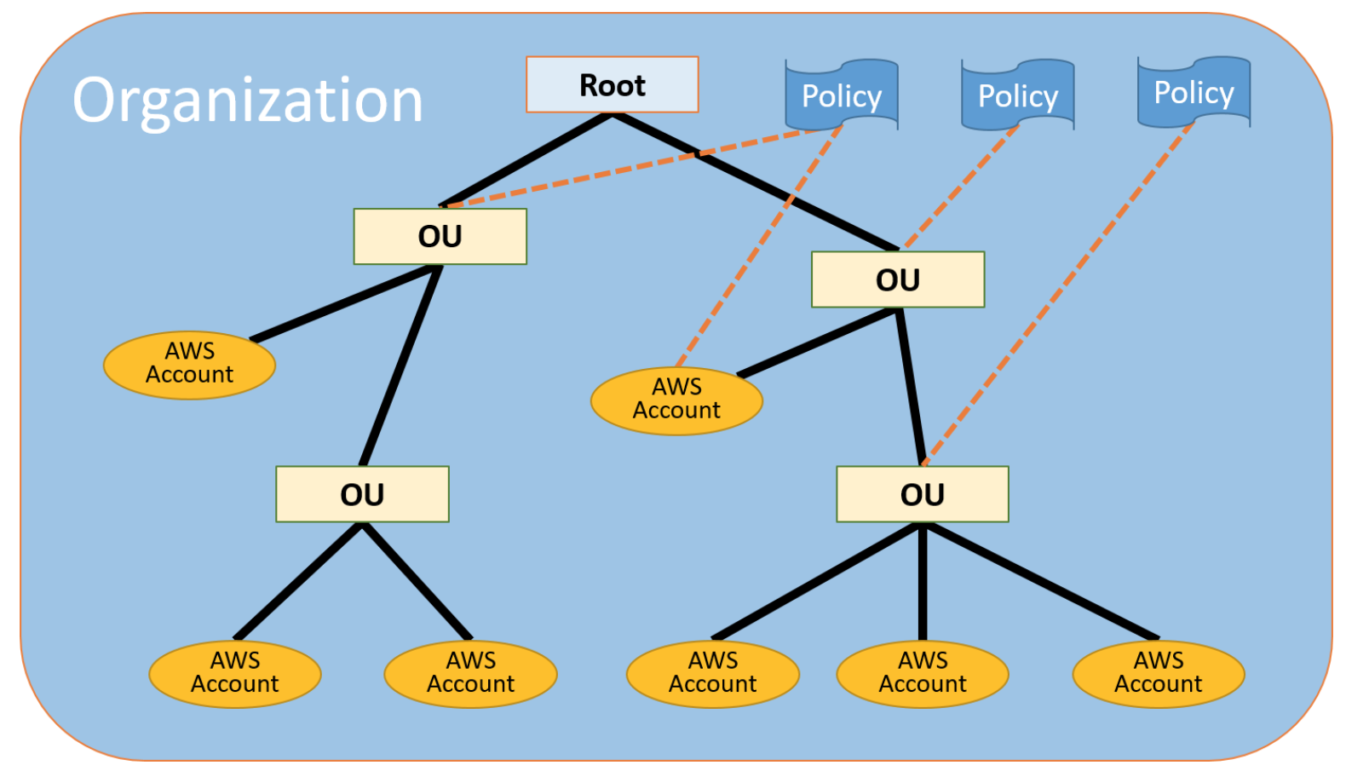
AWS Organizations Terminology
*Organizational Units (OUs)
Notes:
Let’s start with some terminology to understand the structure of AWS Organizations.
The diagram displayed shows a basic organization, or root, that consists of seven accounts organized into four organizational units (or OUs). An OU is a container for accounts within a root. An OU can also contain other OUs enabling you to create a hierarchy that looks like an upside down tree with a root at the top and branches of OUs that reach down ending in accounts that are the leaves of the tree.
When you attach a policy to one of the nodes in the hierarchy, it flows down and affects all of the branches and leaves. This organization has several policies that are attached to some of the OUs or directly to accounts.
An OU can have only one parent and, currently, each account can be a member of exactly one OU. An account is a standard AWS account that contains your AWS resources. You can attach a policy to an account to apply controls to only that one account.

Slide 7

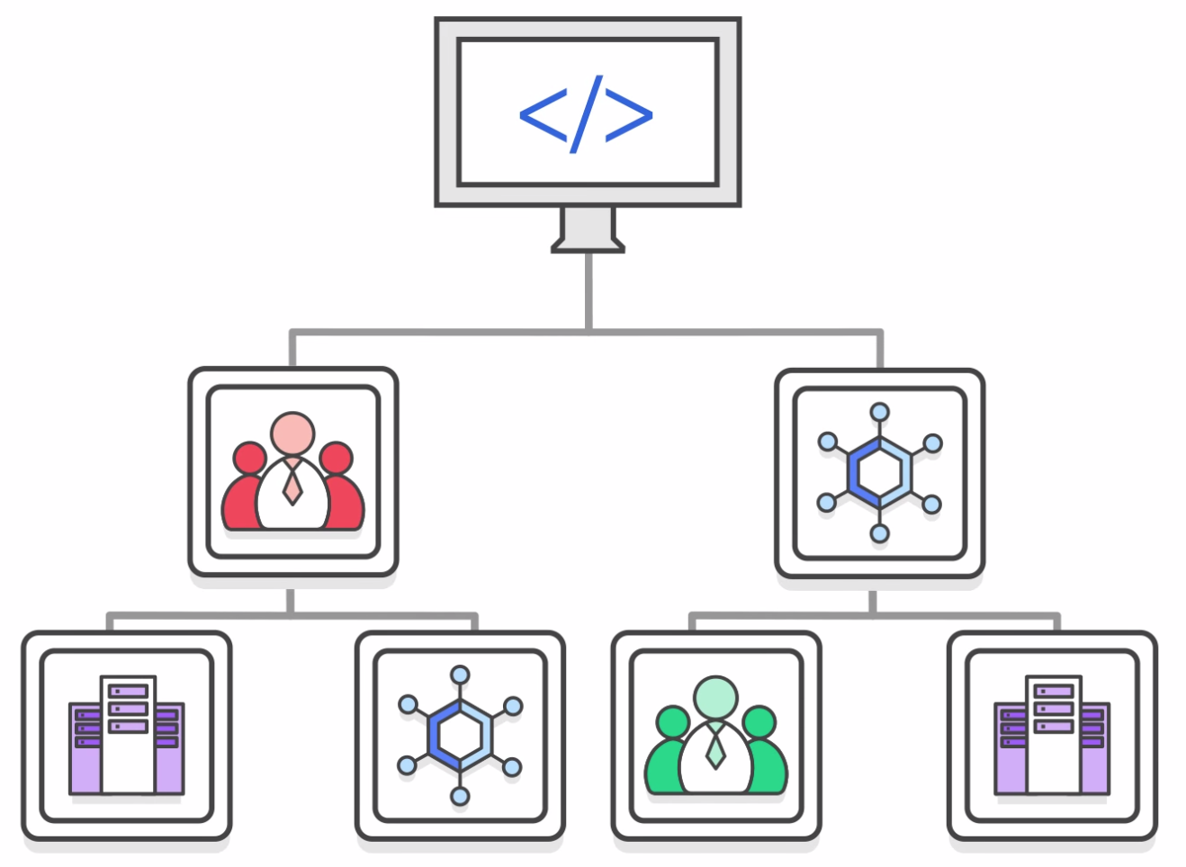

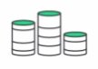
Key Features and Benefits
Policy-Based Account Management
Group Based Account Management
Application Program Interface (APIs) that automate account management
AWS Organizations
Consolidated Billing
Notes:
AWS Organizations enables you to:
Create Service Control Policies (SCPs) that centrally control AWS services across multiple AWS accounts.
You can create groups of accounts and then attach policies to a group to ensure that the correct policies are applied across the accounts.
You can simplify account management by using Application Program Interface (APIs) to automate the creation and management of new AWS accounts.
Simplify the billing process by setting up a single payment method for all the AWS accounts in your organization. With consolidated billing, you can see a combined view of charges incurred by all your accounts as well as take advantage of pricing benefits from aggregated usage. Consolidated billing provides a central location to manage billing across all of your AWS accounts, and the ability to benefit from volume discounts.

Slide 8


Security with AWS Organizations
Service Control Policies (SCPs) enable you to allow or deny access to AWS services for individuals or group accounts in an Organizational Unit (OU).
Control access with AWS Identity and Access Management (IAM).
IAM policies enable you to allow or deny access to AWS services for users, groups, and roles.
Notes:
AWS Organizations does not replace associating AWS Identity and Access Management (IAM). policies with users, groups, and roles within an AWS account.
IAM policies let you allow or deny access to AWS services, such as Amazon S3, as well as individual AWS resources, such as a specific S3 bucket, or individual API actions, such as s3:CreateBucket. An IAM policy can be applied only to IAM users, groups, or roles, and it can never restrict the root identity of the AWS account.
In contrast, with Organizations you use Service Control Policies (SCPs) to allow or deny access to particular AWS services for individual AWS accounts or for groups of accounts within an Organizational Unit (OU). The specified actions from an attached SCP affect all IAM users, groups, and roles for an account, including the root account identity.

Slide 9
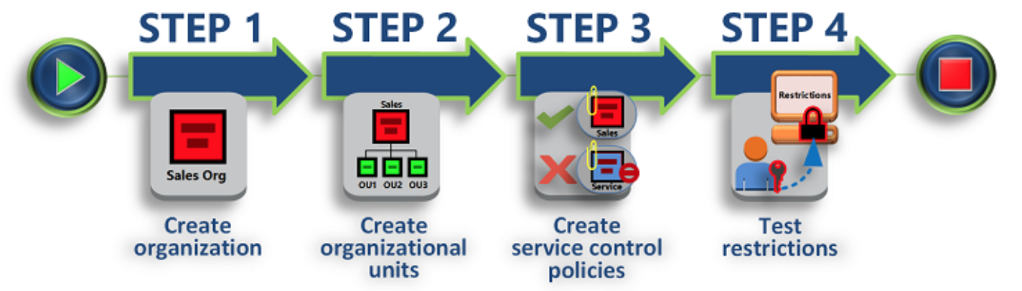
Organizations Set Up
Notes:
Keep in mind that this process assumes you have access to two existing AWS accounts, and that you can sign in to each as an administrator.
To set up AWS Organizations, let’s review each step:
Step 1 is to create your organization with your current AWS account as the master account. You also invite one AWS account to join your organization and create another account as a member account.
Step 2 is to create two Organizational Units in your new organization and place the member accounts in those OUs.
Step 3 is to create Service Control Policies, which allow you to apply restrictions to what actions can be delegated to users and roles in the member accounts by using these service control policies. A service control policy is a type of organization control policy.
Step 4 is to test your organization’s policies. Sign in as a user for each of the roles (such as OU1, OU2, etc.) and see how the service control policies impact account access. Alternatively, you can use the IAM policy simulator to test and troubleshoot IAM and resource-based policies attached to IAM users, groups, or roles in your AWS account.
For more information on the IAM policy simulator, select the link.
https://docs.aws.amazon.com/IAM/latest/UserGuide/access_policies_testing-policies.html.

Slide 10
Limits of AWS Organizations
Limits
Limits on Names | Names must be composed of Unicode characters.
 | Names must not exceed 250 characters in length.
Maximum and Minimum Values | Number of AWS Accounts | Varies. Note: An invitation sent to an account counts against this limit.
 | Number of roots | 1
 | Number of | 1,000
 | Number of policies | 1,000
 | Maximum size of a service control policy document | 5,120 bytes
 | OU maximum nesting in a root | 5 levels of OUs under a root
 | Invitations sent per day | 20
 | Number of member accounts you can create concurrently | Only five can be in progress at one time
 | Number of entities to which you can attach a policy | Unlimited
Notes:
There are restrictions on names that you can create in AWS Organizations, which includes names of accounts, OUs, roots, and policies.
Names must be composed of Unicode characters and not exceed 250 characters in length.
There are a number of maximum and minimum values for entities in the AWS Organizations.

Slide 11



Accessing AWS Organizations
Management Console
Command Line Tools
Software Development Kits (SDKs)
AWS Organizations
HTTPS Query Application Programming Interfaces (API)
Notes:
AWS Organizations can be managed through multiple different interfaces:
The Management Console is a browser-based interface that you can use to manage your organization and your AWS resources. You can perform any task in your organization by using the console.
AWS Command Line Tools allow you to issue commands at your system's command line to perform AWS Organizations and AWS tasks. This can be faster and more convenient than using the console.
You can use also AWS Software Development Kits (SDKs) to take care of tasks such as cryptographically signing requests, managing errors, and retrying requests automatically. AWS SDKs consist of libraries and sample code for various programming languages and platforms, such as Java, Python, Ruby, .NET, iOS, and Android.
The AWS Organizations HTTPS Query API gives you programmatic access to AWS Organizations and AWS. It lets you issue HTTPS requests directly to the service. Note that when you use the HTTPS API, you must include code to digitally sign requests using your credentials.

Slide 12
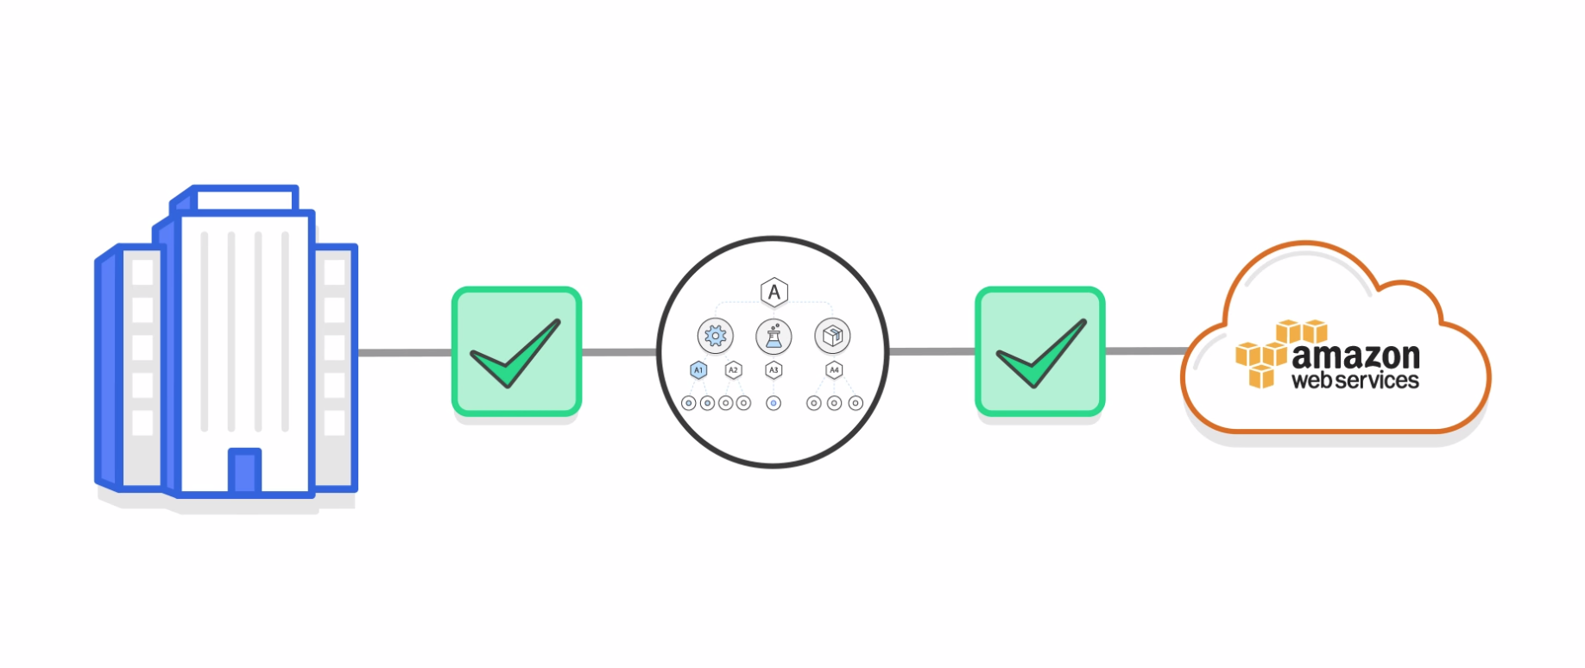
AWS Organizations is Free!
Notes:
AWS Organizations are available to all AWS customers at no additional charge!

Slide 13
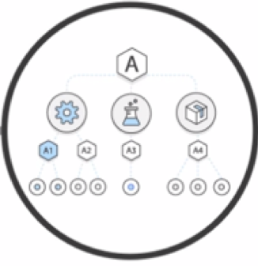
In Review
AWS Organizations helps you programmatically create AWS accounts and consolidate them into a centrally managed organization.
AWS Organizations provides consolidated billing and account management capabilities that help you reach your business goals around:
Budget
Security
Compliance
Notes:
In summary, organizations help you programmatically create AWS accounts and consolidate them into a centrally managed organization.
AWS Organizations provides consolidated billing and account management capabilities that help you reach your business goals around:
Budget
Security
And compliance

Slide 14
Part 2: AWS Billing and Cost Management
Notes:
Introducing Part 2: AWS Billing and Cost Management.

Slide 15
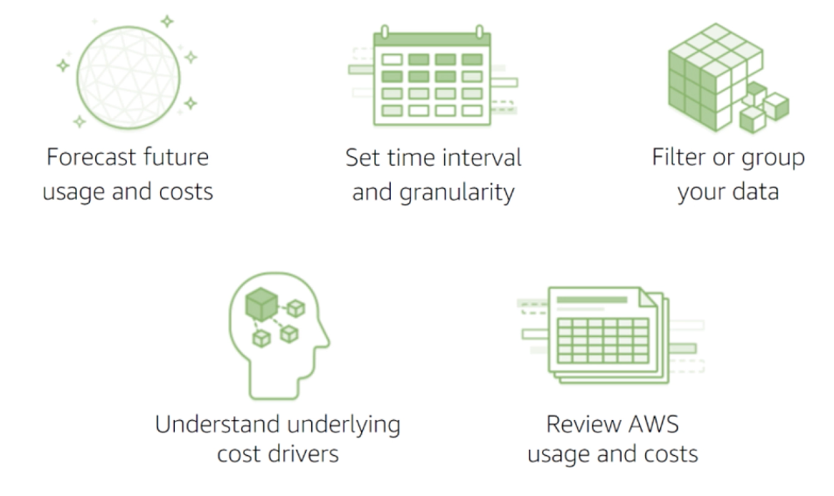
Introducing AWS Billing and Cost Management
Notes:
AWS Billing and Cost Management is the service you use to pay your AWS bill, monitor your usage, and budget your costs. Billing and cost management enables you to forecast and obtain a better idea of what your costs and usage may look like in the future so that you can plan ahead.
You can set a custom time period and determine whether you would like to view your data at a monthly or daily level of granularity.
With the filtering and grouping functionality, you can further analyze your data using a variety of available dimensions. The AWS Cost and Usage Report Tool gives you the ability to understand your cost and usage data trends and how you are using your AWS implementation to identify opportunities for optimization.

Slide 16
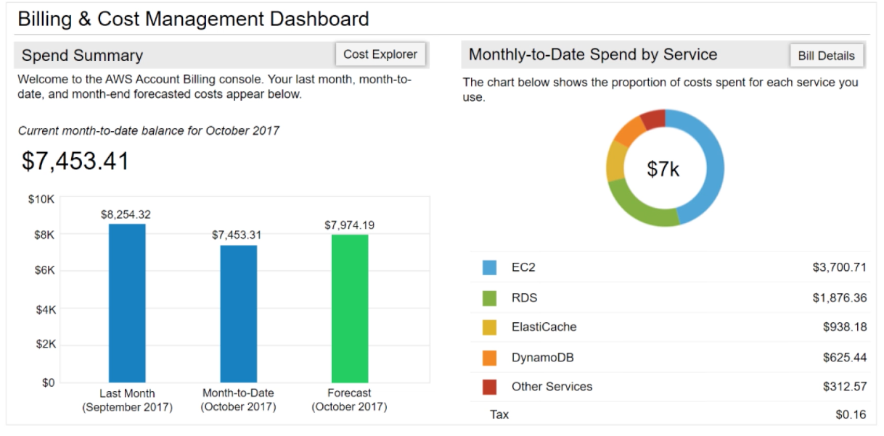
AWS Billing Dashboard
Notes:
The AWS Billing Dashboard lets you view the status of your month to date AWS expenditure, pinpoint the services that account for the majority of your overall expenditure, and understand at a high level how costs are trending.
One of the graphs located on the dashboard is the Spend Summary, which shows you how much you spent last month, the estimated costs of your AWS usage for the month to date, and a forecast for how much you are likely to spend this month.
Another graph is the Month-to-Date Spend by Service graph that shows the top services that you use most and the proportion of costs attributed to that service.

Slide 17
Tools
AWS Bills
AWS Cost Explorer
AWS Budgets
AWS Cost and Usage Reports
Notes:
From the billing dashboard, you can access a number of other cost management tools you can use to estimate and plan your AWS costs including AWS Bills, AWS Cost Explorer, AWS Budgets and AWS Cost and Usage Reports.

Slide 18
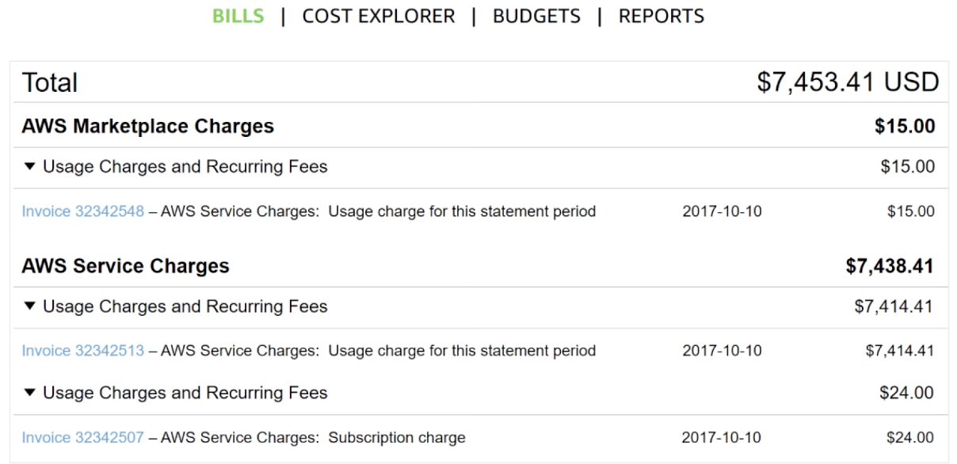
Monthly Bills
Notes:
The AWS Bills page lists the costs that you incurred over the past month for each AWS service with a further breakdown by AWS region and linked account.
This tool gives you access to the most up to date information on your costs and usage including your monthly bill and the detailed breakdown of the AWS services you are using.

Slide 19
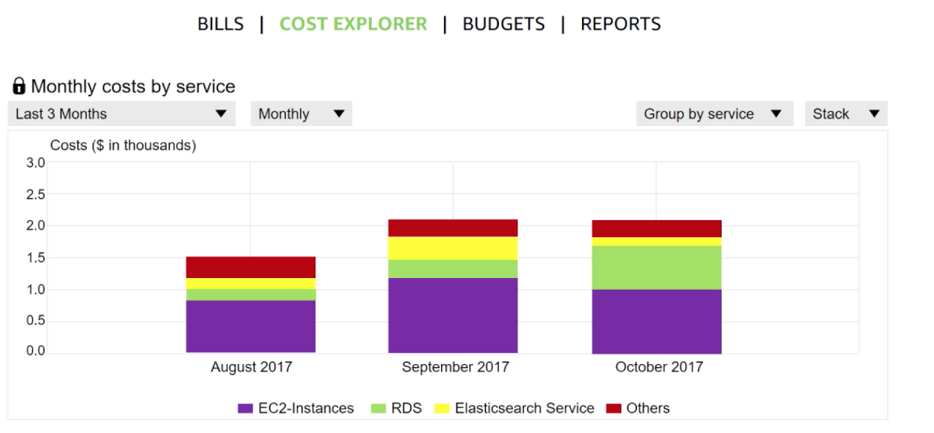
Cost Explorer
Notes:
The AWS Billing and Cost Management console includes the Cost Explorer page for viewing your AWS cost data as a graph.
With Cost Explorer you can visualize, understand, and manage your AWS costs and usage over time.
The Cost Explorer includes a default report that helps you visualize the costs and usage with your top cost incurring AWS services. The monthly running costs report gives you an overview of all of your costs for the past three months and provides forecasted numbers for the coming month with a corresponding confidence interval.
The Cost Explorer is a free tool that allows you to:
View charts of your costs.
View cost data for the past 13 months.
Forecast how much you are likely to spend over the next three months.
Discover patterns in how much you spend on AWS resources over time and identify cost problem areas.
Identify services that you use the most and/or metrics like which Availability Zones have the most traffic or which linked AWS account is used the most.

Slide 20
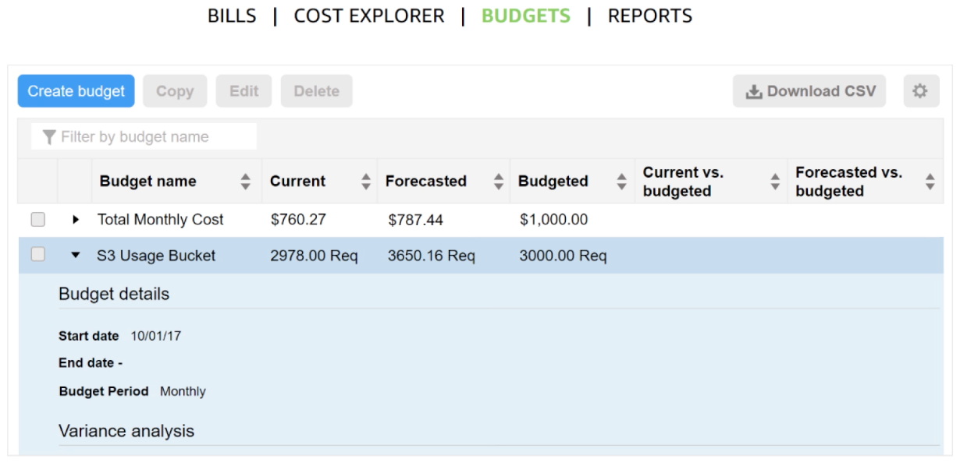
Forecast and Track Costs
Notes:
AWS Budgets uses the cost visualization provided by Cost Explorer to show you the status of your budgets and to provide forecasts of your estimated costs.
You can also use budgets to create notifications if you go over your budget for the month or when your estimated costs exceed your budget. Budgets can be tracked at the monthly, quarterly, or yearly level and you can customize the start and end dates. Budget alerts can be sent via email and/or via Amazon Simple Notification Service (Amazon SNS).

Slide 21
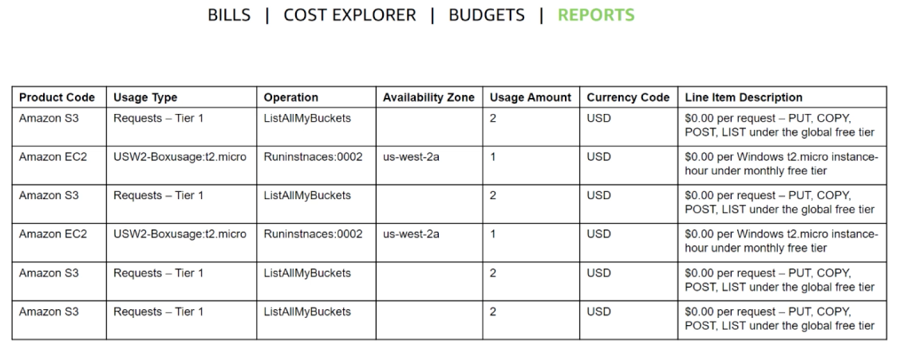
Cost and Usage Reporting
Notes:
The AWS Cost and Usage Report is a single location for accessing comprehensive information about your AWS costs and usage. This tool lists usage for each service category used by an account and its users in hourly or daily line items as well as any tax that you have activated for tax allocation purposes.
You can choose to have AWS to publish billing reports to a Amazon S3 bucket. These reports can be updated once a day.

Slide 22

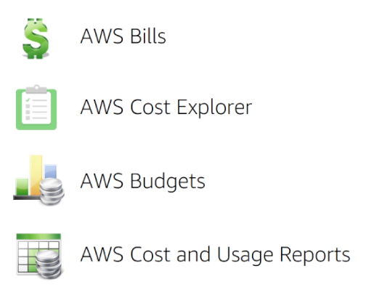
In Review
Tools to help you access, understand, allocate, control and optimize your AWS costs and usage:
Notes:
AWS Billing and Cost Management provides you with tools to help you access, understand, allocate, control and optimize your AWS costs and usage. These tools include AWS Bills, AWS Cost Explorer, AWS Budgets and AWS Cost and Usage Reports.
These tools give you access to the most comprehensive information about your AWS costs and usage including which AWS services are the main cost drivers. Knowing and understanding your usage and costs will enable you to plan ahead and improve your AWS implementation.

Slide 23
Part 3: AWS Support Services
Notes:
Introducing Part 3: AWS Support Services.
Support is an essential element for any system. Outages can result in a loss of productivity, high overhead rates, and even lost customers. Sometimes, it is helpful to have support that can provide deeper insight into a product you are trying to use. To prevent these losses and frustrations and have access to technical resources, you need to understand your support options. Let’s review AWS Support and AWS Support Plans available to you.

Slide 24

AWS Support
Provide unique combination of tools/expertise:
AWS Support
AWS Support Plans
Support is provided for:
Experimenting with AWS
Production use of AWS
Business critical use of AWS
Notes:
Whether you are new or continuing to adopt AWS services and applications as your business solutions, we want help you do amazing things with AWS. AWS Support is there to provide you a unique combination of tools and expertise based on your current or future planned use cases.
AWS Support has been developed to provide complete support and the right resources to aid your success. We want to support all of our customers, including those who may just be experimenting with AWS, those who are looking for production uses of AWS, and also our customers who use AWS as a business-critical resource. AWS Support can vary the type of support provided depending on the customer’s needs and goals in sight.

Slide 25


AWS Support
Proactive guidance:
Technical Account Manager (TAM)
Best practices:
Trusted Advisor
Account assistance:
AWS Support Concierge
Notes:
With AWS, customers can plan, deploy, and optimize with confidence.
If a user would like proactive guidance, AWS Support has Technical Account Managers (TAMs) that are designated as that users primary point of contact. The Technical Account Manager, or TAM, can provide guidance, architectural review, and continuous ongoing communication to keep the user informed and prepared as they plan, deploy, and optimize their solutions.
If a user wants to ensure they follow best practices to increase performance and fault tolerance in the AWS environment, AWS Support has AWS Trusted Advisor. AWS Trusted Advisor is like a customized cloud expert, but is an online resource that checks for opportunities to reduce monthly expenditures and increase productivity.
For account assistance, the Support Concierge is a billing and account expert who will provide quick and efficient analysis on the issue. The concierge addresses all non-technical billing and account level inquiries.

Slide 26

Support Plans
AWS Support offers four support plans:
Basic Support: Resource Center access, Service Health Dashboard, Product FAQs, Discussion Forums, and Support for Health Checks
Developer Support: Support for early development on AWS
Business Support: Customers running production workloads
Enterprise Support: Customers running business and mission-critical workloads
Notes:
At AWS we want you to be able to plan, deploy and optimize with confidence and, to support you, we have developed specific plans to assist including Basic, Developer, Business, and Enterprise support plans.
The Basic Support Plan offers:
24/7 access to customer service, documentation, white papers and support forums.
Access to six core Trusted Advisor checks.
Access to Personal Health Dashboard.
The Developer Support Plan offers resources for customers testing or doing early development on AWS, as well as any customers who:
Want access to guidance and technical support.
Are exploring how to quickly put AWS to work.
Use AWS for non-production workloads or applications.
The Business Support Plan offers resources for customers running production workloads on AWS as well as any customers who:
Run one or more applications in production environments.
Have multiple services activated, or use key services extensively.
Depend on their business solutions to be available, scalable, and secure.
The Enterprise Support Plan offers resources for customers running business and mission-critical workloads on AWS, as well as any customers who want to:
Focus on proactive management to increase efficiency and availability.
Build and operate workloads following AWS best practices.
Leverage AWS expertise to support launches and migrations.
Use a Technical Account Manager (TAM) that provides technical expertise for the full range of AWS services and obtains a detailed understanding of your use case and technology architecture. The Technical Account Manager is the primary point of contact for ongoing support needs.

Slide 27
Support Plan Prices
 | BASIC | DEVELOPER | BUSINESS | ENTERPRISE
Cost | FREE | Greater of $29 / month or 3% of monthly AWS usage | Greater of $100 / month or 10% of monthly AWS usage for the first $0–$10K 7% of monthly AWS usage from $10K–$80K 5% of monthly AWS usage from $80K–$250K 3% of monthly AWS usage over $250K | Greater of $15,000 or 10% of monthly AWS usage for the first $0–$150K 7% of monthly AWS usage from $150K–$500K 5% of monthly AWS usage from $500K–$1M 3% of monthly AWS usage over $1M
Tech Support |  | Business hour access via email | 24x7, email, chat & phone | 24x7, email, chat & phone
Technical Account Manager (TAM) | NO | NO | NO | YES
Who can open cases? | No one | 1 Person / Unlimited Cases | Unlimited Contacts / Unlimited Cases | Unlimited Contacts / Unlimited Cases
Notes:
Displayed are the support plans offering different services and price points.
Select the links to learn more.
https://aws.amazon.com/premiumsupport/pricing/.
https://aws.amazon.com/premiumsupport/compare-plans/.

Slide 28
Case Severity & Response Times
 | Critical | Urgent | High | Normal | Low
Basic | No Case Support
Developer Plan (Business hours) |  |  |  | 12 hours or less | 24 hours or less
Business Plan (24 x 7) |  | 1 hour or less | 4 hours or less | 12 hours or less | 24 hours or less
Enterprise Plan (24 x 7) | 15 minutes or less | 1 hour or less | 4 hours or less | 12 hours or less | 24 hours or less
Notes:
It addition to understanding the costs associated with different support plans, it is critical to understand the service levels associated with each plan. In addition to the support plan you have selected, the case severity will drive the type of response that you receive. There are five different severity levels:
Critical: Your business is at risk. Critical functions of your application are unavailable.
Urgent: Your business is significantly impacted. Important functions of your application are unavailable.
High: Important functions of your application are impaired or degraded.
Normal: Non-critical functions of your application are behaving abnormally, or you have a time-sensitive development question.
Low: You have a general development question, or you want to request a feature.
Note that there is no case support with the Basic Support Plan. These response times should be considered when determining which support plan is best for your organization.
Select the link to review a full support plan comparison.
https://aws.amazon.com/premiumsupport/compare-plans/.

Slide 29
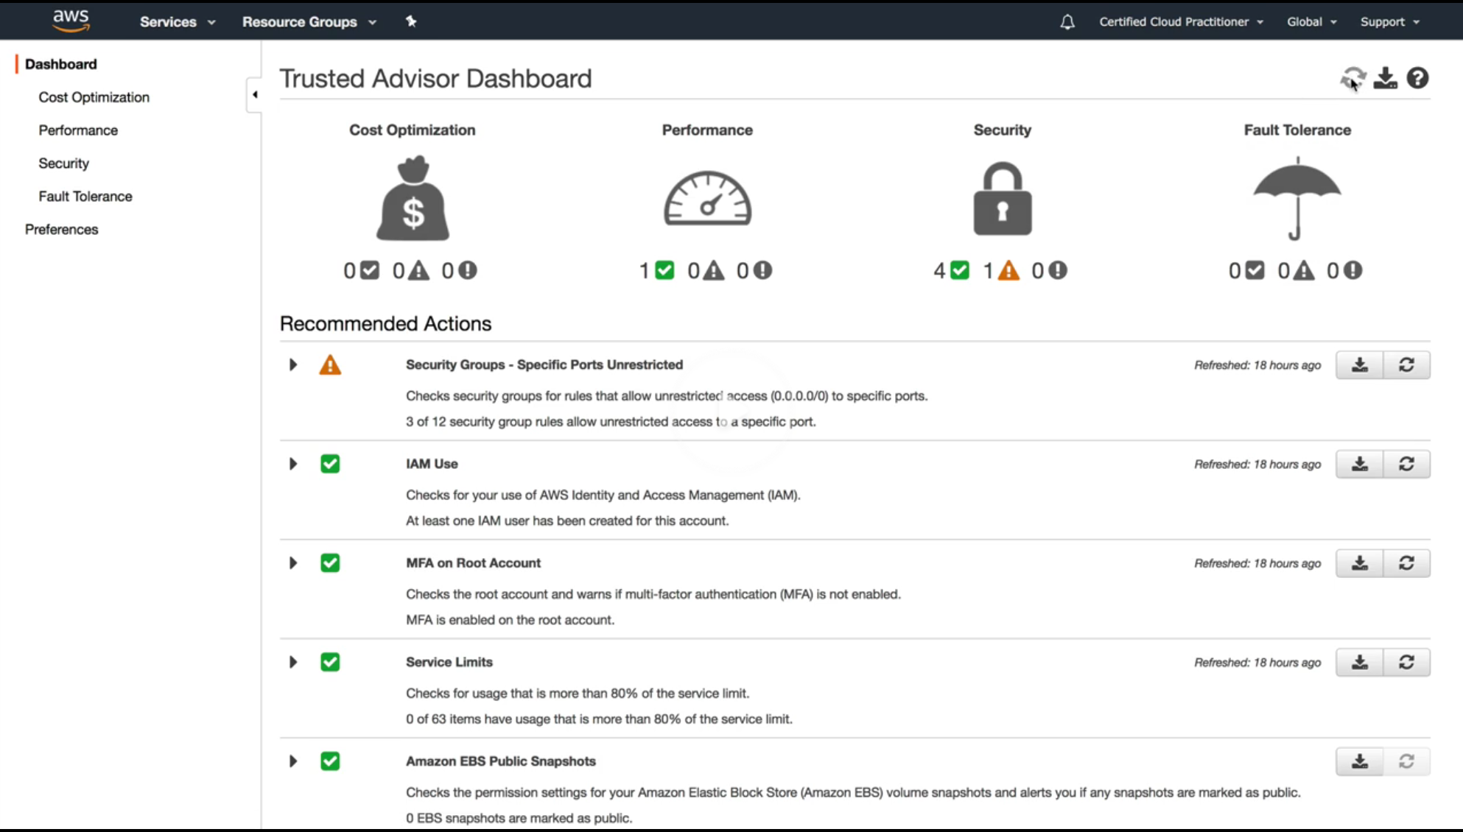
AWS Trusted Advisor
Online resource to:
Reduce cost
Increase performance
Improve security
Core checks and recommendations available to all customers.
Full Trusted Advisor benefits available with Business or Enterprise support plans.
Located in the Management Tools section of the console.
Notes:
An AWS Trusted Advisor is available to help users follow best practices that increase performance and fault tolerance of their AWS environment. Trusted Advisor is an online resource to help you reduce costs, increase performance, and improve security by optimizing your AWS environment.
There are two types of trusted advisor options:
Core checks and Recommendations come with all accounts.
Full Trusted Advisor for Business and Enterprise support offerings.
Access AWS Trusted Advisor from the Management Tools section of the console.
The Trusted Advisor provides real-time guidance to help you provision your resources following AWS best practices and to advise you on cost optimization, performance, security, and fault tolerance.
An AWS Trusted Advisor is not focused on just one service and it is not just a security tool. An AWS Trusted Advisor will tell you how the infrastructure is performing, when security groups have been left open to the world, whether or not you are using fault tolerance, if you are at risk with all everything deployed in an Availability Zone, or if you have resources deployed that you are not using, but are still being charged for.

Slide 30
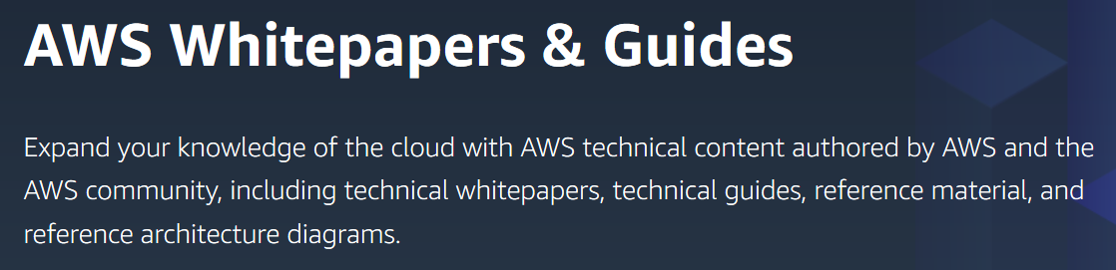
AWS White Papers and Documentation
AWS White Papers are:
Available at https://aws.amazon.com/whitepapers
Collection of technical documents that outline AWS topics including:
Architecture best practices
Security best practices
Cloud Computing Economics
Serverless Architecture
Notes:
AWS White Papers are a collection of technical documents that outline many AWS relevant topics like architecting best practices and security best practices, Cloud Computing Economics and Serverless Architecture. You can access them by selecting the link.
These technical documents cover a tremendous range of ideas, thoughts, and concepts that apply to cloud computing and AWS services.

Slide 31

In Review
AWS Support Plans include:
Basic Support plan
Developer Support plan
Business Support plan
Enterprise Support plan
All support plans include
24/7 access to customer service
AWS documentation, whitepapers, support forums
Access to six core trusted advisor checks
Access to personal health dashboard
For resources beyond included services, select either the Developer, Business, or Enterprise support plans.
Notes:
AWS Support offers several different plan options that were created to fit your unique needs. These plans include the Basic Support Plan, the Developer Support Plan, Business Support Plan and the Enterprise Support Plan.
All support plans provide 24/7 access to customer service, AWS documentation, whitepapers, and support forums, access to six core Trusted Advisor Checks, and access to the personal Health Dashboard.
When additional technical support and support resources beyond this are required, you have the option to select from the Developer, Business, and Enterprise options to fit your unique business needs.

Slide 32

In Summary
Discussed Organizations to understand options for account set up
Reviewed AWS Billing and Cost Management to understand how to have visibility to AWS costs
Identify alternative Support options and features
Up Next…
Complete:
Knowledge Assessment
Notes:
In summary, we discussed Organizations to understand different setup options and their impact on costs.
We reviewed different AWS Billing and Cost Management tools to understand how to gain visibility into AWS costs, and identified alternative AWS Support Plan options and features.
Please take a moment to complete the Knowledge Assessment.

Slide 33
Thanks for participating!
© 2018 Amazon Web Services, Inc. or its affiliates. All rights reserved. This work may not be reproduced or redistributed, in whole or in part, without prior written permission from Amazon Web Services, Inc. Commercial copying, lending, or selling is prohibited. Corrections or feedback on the course, please email us at: aws-course-feedback@amazon.com. For all other questions, contact us at: https://aws.amazon.com/contact-us/aws-training/. All trademarks are the property of their owners.
Notes:
Thanks for participating!

